Slide 1

Twin Valley Roundtable
November 14, 2019

Slide 2

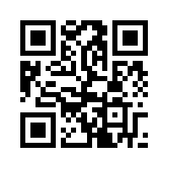
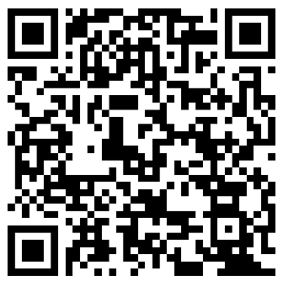
Be Sure to Sign Attendance Sheet
Want a copy of tonight's slides, scan here!
Or, scan here!

Slide 3

Why Come to Roundtable?
New to Roundtable, raise your hand and welcome
Roundtable provide
  Sharing of Knowledge & Scout Fellowship
  Staying current on National, Council and District Topics
  Network of fellow scouters outside your unit
  Forum to get answers to your questions
My Roundtable Rules
Start promptly at 7:00
Combined session 20 minutes
Ends promptly at 8:30
If you want a copy of this presentation, email me.

Slide 4
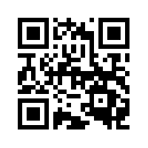
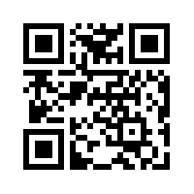
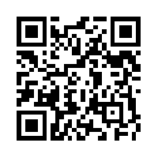
Twin Valley People
Scout BSA Roundtable Commissioner
  Peter Zischka
  2vroundtable@gmail.com/(925) 916-7005
Cub Scout Roundtable Commissioner
  Jeff Biehl
  tvcubroudtable@gmail.com/(925) 447-1519
District Committee Chair
  This could be you!
District Commissioner
  Michael Allison
  tvcommissioners@gmail.com
District Executive
  Matt Lindberg
  matt.lindberg@scouting.org
Scout BSA Roundtable Commissioner
  Peter Zischka
  2vroundtable@gmail.com
  (925) 916-7005
Cub Scout Roundtable Commissioner
  Jeff Biehl
  tvcubroudtable@gmail.com
  (925) 447-1519
District Committee Chair
  This could be you!
District Commissioner
  Michael Allison
  tvcommissioners@gmail.com
District Executive
  Matt Lindberg
  matt.lindberg@scouting.org

Slide 5

District & Council Websites
SFBAC Council
  http://www.sfbac.org/
Twin Valley District
  http://www.TwinValleyScouting.com/
  http://www.sfbac.org/2877
Looking for help maintaining the Twin Valley website. Experience with Wordpress helpful. Contact Matt Lindberg

Slide 6
A Look Ahead – Calendar
November
1st ~ Sporting Clays for Scouting
1st-3rd ~ Twin Valley WEBELOS Weekend
2nd ~ 35th Annual Gala and Auction
9th ~ Scouting for Food (hangers)
13th ~ District Committee Meeting
14th ~ Roundtable
16th ~ Scouting for the Community (pickup)
22nd ~ Royaneh Thanksgiving Work Party
23rd ~ Swimming Merit Badge Day
25th ~ Fall Exploration Camp
December
6th Scout Center Sleepover (Scouts BSA)
11th ~ District Committee Meeting
12th ~ Roundtable
~ Youth Protection Training
14th ~ Level 1 USA Archery Instructor Training
14th-15th ~ Shooing Sports @ Rancho Los Mochos
23rd-27th ~ Winter Exploration Camp
30th-3rd ~ Winter Exploration Camp
January
8th ~ District Committee Meeting
9th ~ Roundtable
11th ~ Pinewood Derby Tune-up
~ Fundamentals of Training & Trainer’s EDGE
25th ~ Scoutmaster/ASM Position Specific Leader Training
Calendar has been updated, make sure you pick up a copy.

Slide 7
Troop Recruiting for WEBELOS
When: December Roundtable
Format:
  Have your SPL pitch your troop to the WEBELOS (no adults)
  Each troop is allowed four minutes to advertise their unit
  Send me one slide about your troop or just tell me you are coming
  After all presentations, units are invited to host a table for WEBELOS to ask questions.
Cub leaders, bring your WEBELOS to December’s Roundtable
  Peter Zischka ~ 2vroundtable@gmail.com

Slide 8
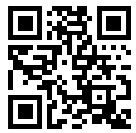
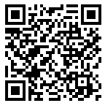
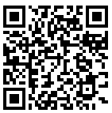
PAIA and BSA Fee Change
No PAIA increase this year.
BSA fee:
  $60.00/scout
  $36/adult
  Boy’s Life $12.00
  Unit $60.00
30 min Q&A session on PAIA and BSA fees and suggestions for fundraising.
Sridhar Ramanathan
sridhar@aventigroup.com
Time: Nov 19 @ 12:00 PM
https://zoom.us/j/911272133?pwd=anB6YVR6L
1d2aWJvc2Z0akhBR0djdz09
Meeting ID: 911 272 133
Password: 362418
One tap mobile
+17207072699,,911272133# US
+16465588656,,911272133# US
Dial by your location
+1 720 707 2699 US
+1 646 558 8656 US
Meeting ID: 911 272 133
Time: Nov 19 @ 7:00 PM
https://zoom.us/j/346117599?pwd=RmNnRWtqSzRL
YTF6dE9MUTFXRGNNZz09
Meeting ID: 346 117 599
Password: 574621
One tap mobile
+17207072699,,346117599# US
+16465588656,,346117599# US
Dial by your location
+1 720 707 2699 US
+1 646 558 8656 US
Meeting ID: 346 117 599

Slide 9
BSA Background Check
New BSA initiative requiring re-checks of adult Criminal Background every 5 years
Starts January 1st, 2020
Registered adults must review two disclosure notices, sign, and return form authorizing the re-check to be conducted
  Adults associated with a unit; return form with the unit’s recharter pack
  Adult not associated with a unit; return form directly to the Council office
If you do not authorize a renewal of your Criminal Background Check, you will not be re-registered
Matt Lindberg

Slide 10
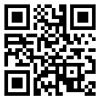
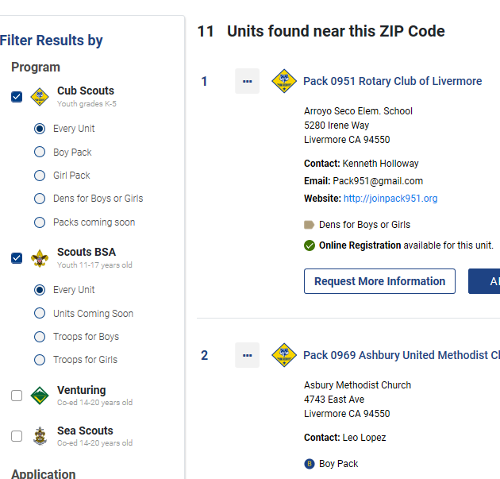
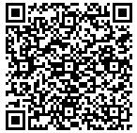
Unit Finder Website
https://beascout.scouting.org/
To update info
https://www.google.com/amp/s/
blog.scoutingmagazine.org/2019/01/28/
update-your-beascout-pin-today-so-future
-scouting-families-can-find-you-tomorrow/
amp/

Slide 11

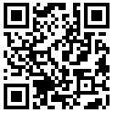
Scouting for the Community
Land Grab: Oct 10th (Before Roundtable)
Door Tag Drop Off: Nov 9th
Donation Pickup: Nov 16th
  Lucky's 2000 Portola Blvd, Livermore - Thrift Center truck starting at 12:30
  Walmart 4501 Rosewood Dr, Pleasanton - Salvation Army truck all day
Shannon Carroll
Matt Lindberg
mrsshannonpack901@gmail.com
matt.lindberg@scouting.org

Slide 12

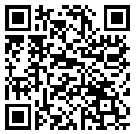
Reporting Service Hours
Why report service hours?
  It helps the district and council track how we are helping the community. These hours are used for JTE reporting to the national level.
How to report hours
  https://servicehours.scouting.org/UI/Security/Login.aspx
What hours are reportable?

Slide 13
Recharter Packets Due Nov 29th
Drop off locations:
  San Leandro Council office
  Nov 19th, 7:00-9:00
    Starbucks (4333 First St., Livermore)
  Nov 21st, 7:00-9:00
    Pleasanton Library
Packets must include (for each registered adult)
  YPT training completion certificate, valid thru 2021
  Singed California Disclosure form with signature

Slide 14


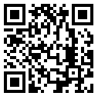
Wood Badge - 2020
Dates:
  March 27-29 @ San Leandro Scout Office
  April 18-19 @ Rancho Los Mochos
Cost: $280.00 per Participant
  Early discount of $25.00 before 12/15/2019
  Late fee of $20.00 after 2/15/2020
Contact: sfbacwoodbadge2020cd@gmail.com
Course Director
Mike Ransom
Notes:
John Bird

Slide 15
Shooting Sports @Rancho Los Mochos
Why:
  Cub Scouts will choose between BB-guns or archery and dedicate their half-day session to practicing that skill.
  Scouts BSA will have the opportunity to shoot archery, rifle and shotgun throughout the day on their own schedule
When: December 14th (actually, your unit can reserve a range any weekend)
  Morning Session: 9:00-12:00
  Afternoon Session: 1:00-4:00
Where: Rancho Los Mochos
Who: All Packs, Troops, Crews and Ships
Registration: 9/19-12/6
Cost:
  Rifle Range can be reserved at $300 for your full unit
  BB and Archery is $10 per person with a minimum cost of $160

Slide 16

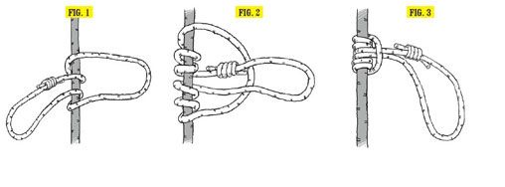
Jumar Relay Race
The Jumar knot is used for self-arrest

Slide 17

Council and District Announcements
Mike Allison
Matt Lindberg

